Slide 1
Final exam Group 5
13.B

Slide 2
Project Description
Our tasks:
Designing the network
Simulating the network in Cisco Packet Tracer
Windows and Linux server configuration
Creating project documentation, creating the PowerPoint presentation

Slide 3
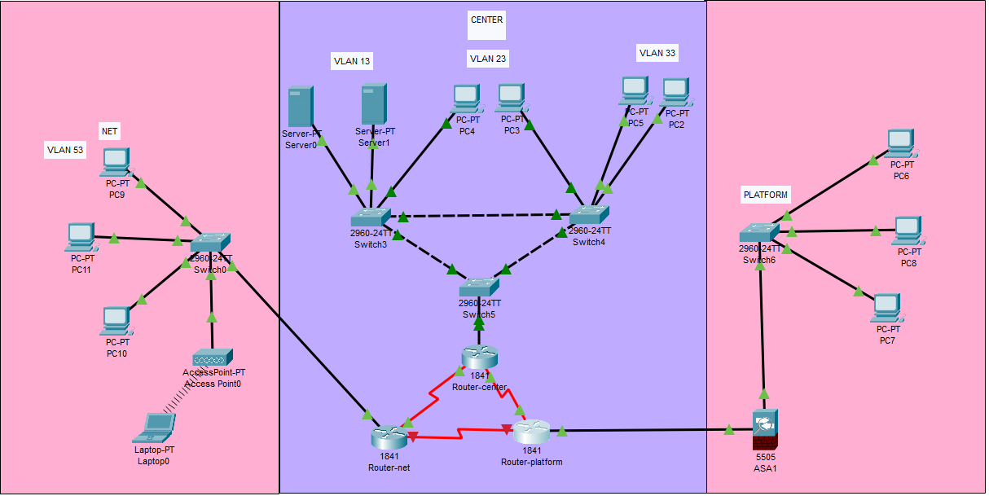
All three of us helped design and configure the network.

Slide 4
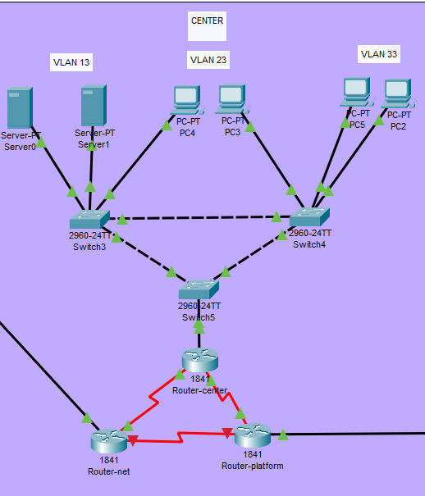
Center site
Számadó Milán and Harkály Krisztián configured the VLANs and DHCP at the Center location.

Slide 5
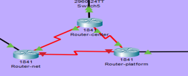
All three members helped configure HSRP and OSPF on the three routers.

Slide 6
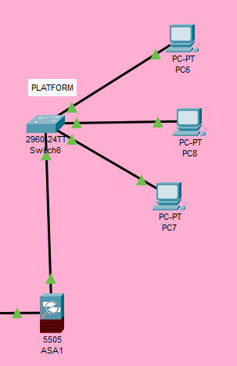
Platform site
At this location, Horváth Márió configured DHCP and the VLAN.

Slide 7
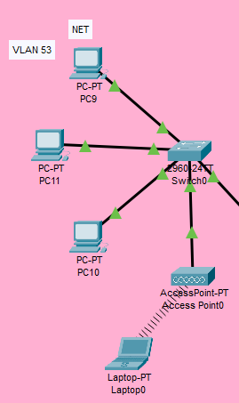
Net site
DHCP and the VLAN at this location was also implemented by Horváth Márió.

Slide 8
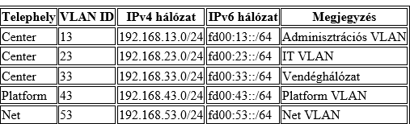
Network Addressing

Slide 9
Word document
The document was created by Számadó Milán and Harkály Krisztián.
The document contains the project description, and how the project was planned out.
It documents, in detail, every single aspect of the project.

Slide 10
The Word document contains a list of all used devices, technologies, and a description of every single component of the network.

